Slide 1

Blockchain Technology in Remittances

Slide 2



Introduction
The global remittance industry serves as a vital lifeline for millions of individuals and families worldwide, facilitating the transfer of funds across borders to support basic necessities, education, healthcare, and investments.
However, traditional remittance methods are plagued by inefficiencies such as high transaction fees, long processing times, lack of transparency, and limited accessibility.
Blockchain technology emerges as a transformative solution, offering the potential to revolutionize cross-border payments and reshape the remittance landscape.

Slide 3
Problem statement
Challenges in traditional remittance methods:
High fees eat into the value of transfers, particularly affecting smaller amounts.
Lengthy processing times delay recipients' access to funds, impacting urgent needs.
Lack of transparency leads to distrust and vulnerability to fraud or errors.
Limited accessibility excludes unbanked populations from formal financial services.

Slide 4
Solution
Blockchain-based remittance solutions address these challenges:
Decentralization removes the need for intermediaries, reducing costs and processing times.
Transparency ensures all transactions are recorded on a tamper-proof ledger, enhancing accountability.
Security measures such as encryption and smart contracts protect users' financial data and transactions.
Accessibility allows anyone with internet access to participate, empowering the unbanked population.

Slide 5
Unique Selling Proposition
USP of blockchain-based remittance solutions:
Faster transactions: Settlements occur in minutes rather than days.
Lower fees: Reduced costs for users due to elimination of intermediaries.
Enhanced transparency: Real-time tracking and visibility of transactions.
Decentralized architecture: Trustless system without reliance on single entities.

Slide 6
Market Overview
Target market includes:
Migrant workers sending money to families.
Managing financial obligations in home countries.
International students receiving funds for education expenses.
Small and medium-sized enterprises (SMEs) engaged in international trade.

Slide 7
Customer Profiling
Demographic profiles:
Migrant workers: Seeking affordable and reliable remittance services.
Financial obligations: Needing convenient solutions for cross-border transactions.
International students: Requiring timely access to funds for education.
SMEs: Looking for efficient payment solutions to manage business operations.

Slide 8
Competition and Barriers to Entry
Competitive landscape:
Established remittance giants like Western Union and MoneyGram.
Emerging fintech startups offering blockchain-based solutions.
Barriers to entry:
Regulatory compliance: Complex legal requirements vary across jurisdictions.
Technological expertise: Building and maintaining secure blockchain infrastructure.
Market adoption: Overcoming customer inertia and building trust in new solutions.

Slide 9
Product and Service
Features of blockchain-based remittance services:
User-friendly platforms for initiating and tracking transactions.
Multi-currency wallets for storing and managing digital assets.
Additional features such as real-time exchange rate information and instant settlement.

Slide 10
Distribution Channels
Distribution channels include:
Online platforms and mobile applications for seamless user experience.
Partnerships with financial institutions for broader accessibility.
Integration with existing payment networks for interoperability.

Slide 11
Revenue Model
Revenue streams:
Transaction fees based on volume or flat rates.
Exchange rate markups to generate profit.
Premium services such as faster processing or enhanced security.
Partnerships and collaborations with financial institutions.
Advertising and marketing partnerships for additional income.

Slide 12
Milestones and Roadmap
Milestones achieved and planned roadmap:
Technology development: Building and testing blockchain infrastructure.
Regulatory compliance: Obtaining licenses and approvals.
User acquisition: Marketing campaigns and strategic partnerships.
Revenue generation: Increasing transaction volume and expanding services.
Geographic expansion: Entering new markets and regions.

Slide 13
Conclusion
Blockchain-based remittances offer a transformative solution to the challenges of traditional cross-border payments.
By leveraging blockchain technology, remittance providers can create a more inclusive, efficient, and transparent financial system.
The future of blockchain-based remittances is promising, with opportunities for innovation, growth, and positive socioeconomic impact.

Slide 14
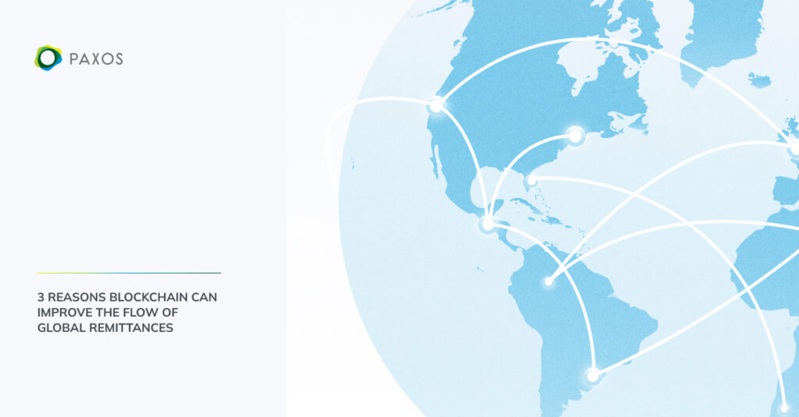
THANK YOU !
Submitted By:
Nandini Gupta (2320982648)
Akshay Paul (2320982515)

